Slide 1
The Progress in CPU Performance

Slide 5
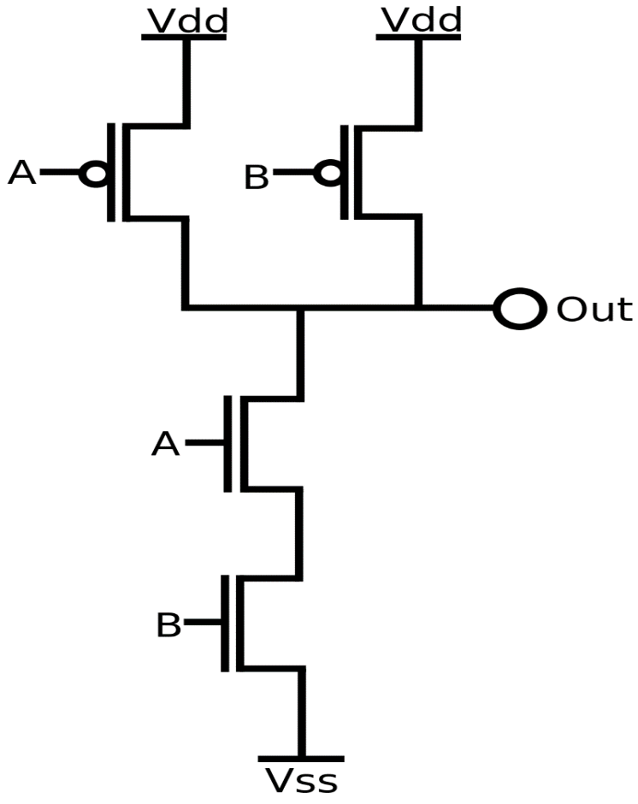
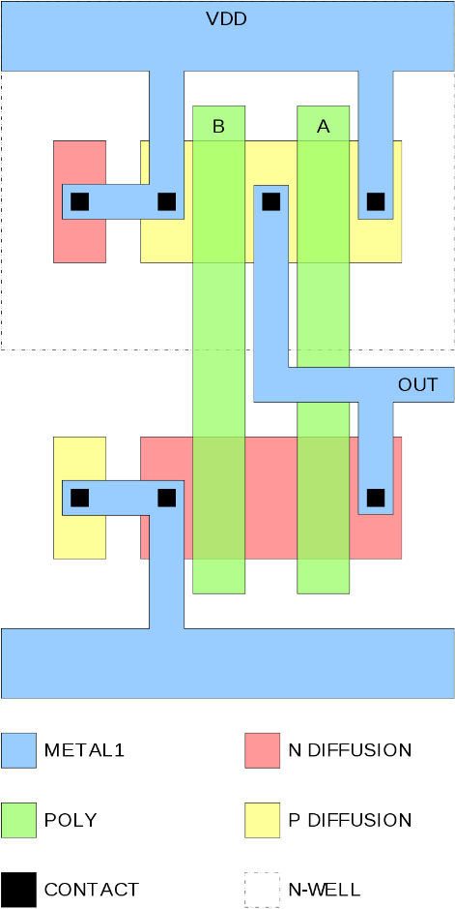
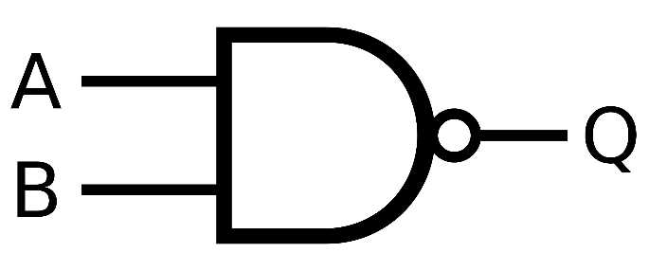
Logic (gate) level
Four transistors constitute a NAND gate
  Two inputs: A, B
  Output = !(A&&B)
  High voltage on both inputs closes the p-type transistors (current sources, top) and opens the n-type transistors (current sink, bottom)

Slide 6
Logic level
Power consumption
  Gates and wires connected to Out form a capacitor which must be charged and discharged in each cycle – proportional to frequency, reduced by Dennard scaling
  Short-circuit current (all transistors are open during state changes)
  Leakage through closed transistors – increased by geometry scaling down

Slide 13
CPU architectures used in high-performance computing

Slide 14
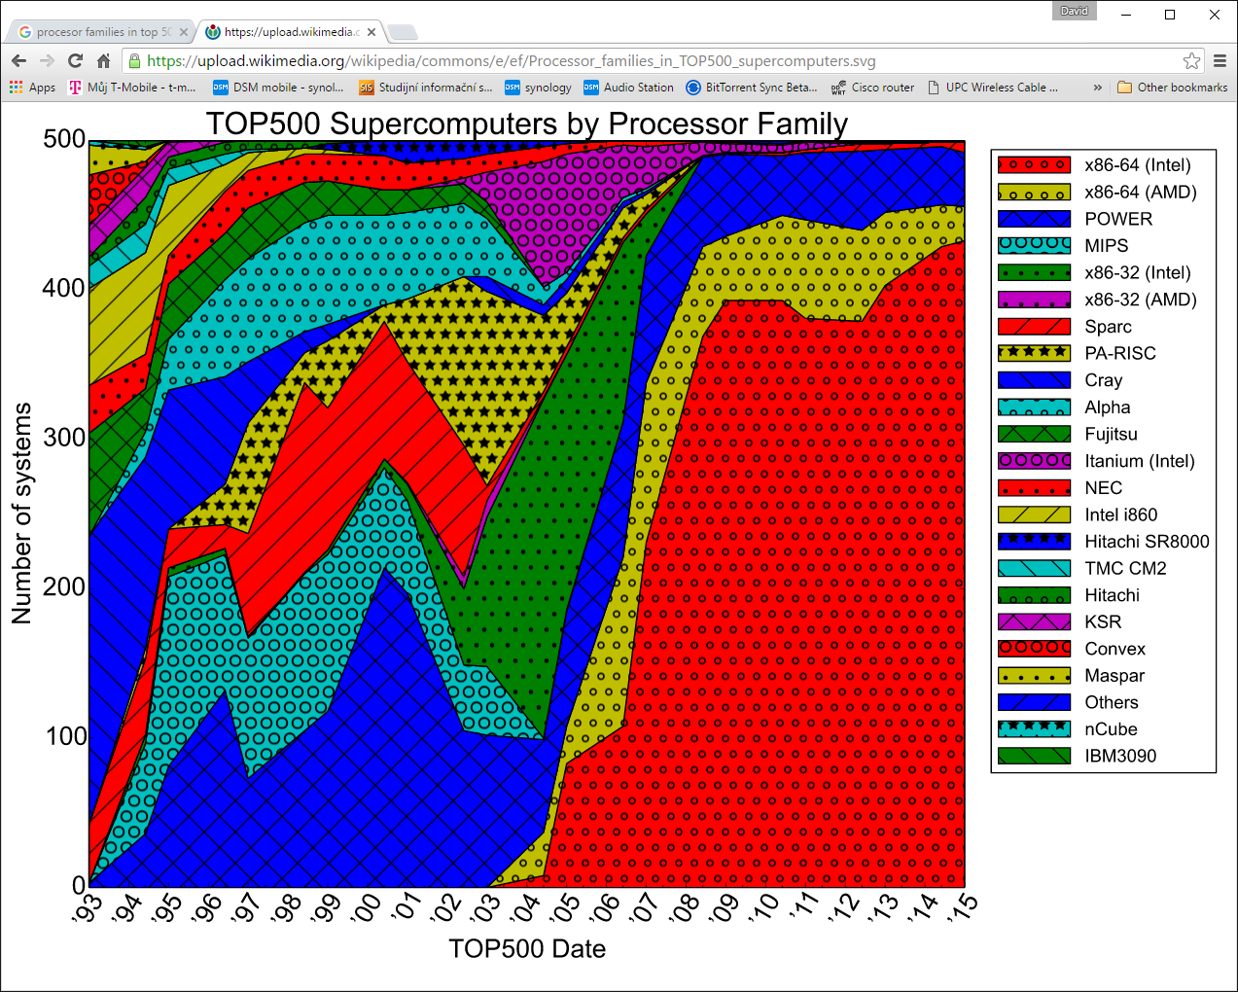

Slide 15
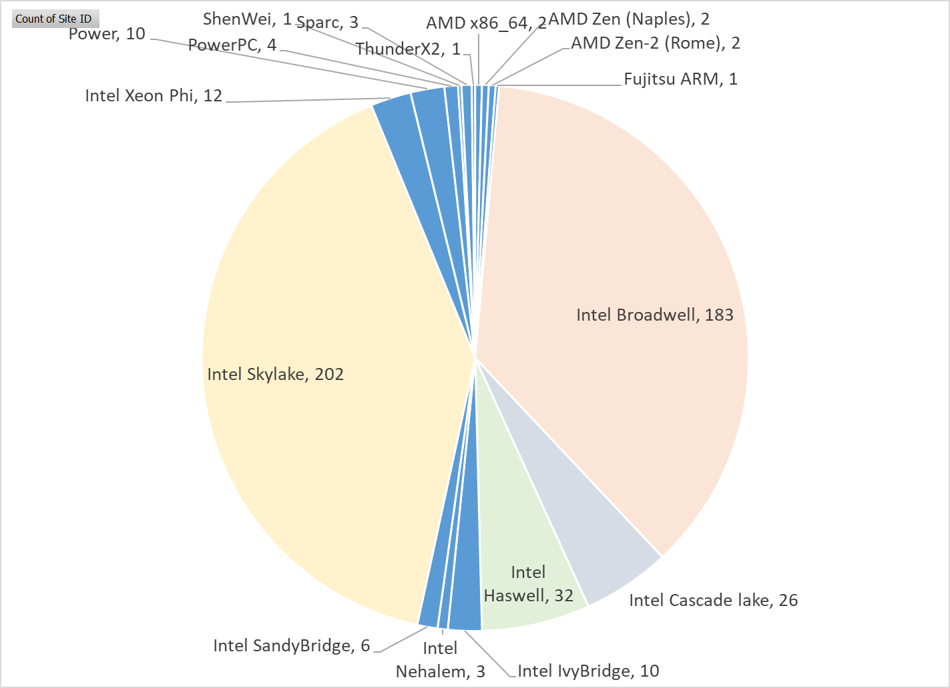
Top500 Supercomputers (Nov 2019) – CPU types

Slide 16
TOP500 list – Nov 2019
Rank | TFlop/s | Name | Country | Total Cores | Cores per Socket | Processor Generation | Accelerator/Co-Processor Cores | Accelerator/Co-Processor | Interconnect
1 | 148600 | Summit | United States | 2414592 | 22 | IBM POWER9 | 2211840 | NVIDIA Volta GV100 | Dual-rail Mellanox EDR Infiniband
2 | 94640 | Sierra | United States | 1572480 | 22 | IBM POWER9 | 1382400 | NVIDIA Volta GV100 | Dual-rail Mellanox EDR Infiniband
3 | 93015 | Sunway TaihuLight | China | 10649600 | 260 | Sunway |  |  | Sunway
4 | 61445 | Tianhe-2A | China | 4981760 | 12 | Intel Xeon E5 (IvyBridge) | 4554752 | Matrix-2000 | TH Express-2
5 | 23516 | Frontera | United States | 448448 | 28 | Xeon Platinum 82xx (Cascade Lake) |  |  | Mellanox InfiniBand HDR
6 | 21230 | Piz Daint | Switzerland | 387872 | 12 | Intel Xeon E5 (Haswell) | 319424 | NVIDIA Tesla P100 | Aries interconnect
7 | 20159 | Trinity | United States | 979072 | 68 | Intel Xeon Phi |  |  | Aries interconnect
8 | 19880 | AI Bridging Cloud Infrastructure (ABCI) | Japan | 391680 | 20 | Xeon Gold | 348160 | NVIDIA Tesla V100 SXM2 | Infiniband EDR
9 | 19477 | SuperMUC-NG | Germany | 305856 | 24 | Xeon Platinum |  |  | Intel Omni-Path
10 | 18200 | Lassen | United States | 288288 | 22 | IBM POWER9 | 253440 | NVIDIA Tesla V100 | Dual-rail Mellanox EDR Infiniband
375 | 1458 | Salomon | Czech Republic | 76896 | 12 | Intel Xeon E5 (Haswell) | 52704 | Intel Xeon Phi 7120P | Infiniband FDR

